Slide 1

BUSINESS ANALYTICS CLUB
Workshop Series 9.19
SQL and Supply Chain Management
Nicole Lee
Eddie Shim

Slide 2
Learning Objective
Identify potential operations issues of a large company
Understand what relational databases are
Distinguish between tables, records, fields, and field values
Be able to write queries in SQL to answer questions
Understand basic database concepts like normalization and entity relationships
Apply data to decisions in supply chain management

Slide 3
General Mills Supply Chain
You’re a supply chain analyst at General Mills, one of the top manufacturers of consumer foods. General Mills sells its products to retail stores. You are given a dataset with consumers, products, shippers, and suppliers.
Although General Mills is a US Company, your boss wants you to find ways of lowering shipping and production costs within and outside the US.
You must figure out which suppliers and shippers the General Mills should keep.

Slide 4
Database Terms
What are databases?
Collections of info organized by logical structure of that info
Database management software
Software to create, store, organize, and retrieve data from a database
Proprietary: Oracle, Access, SQL Server
Open Source: PostgreSQL, MySQL
Database administrator (DBA)
Person responsible for dev. & ops of a database

Slide 5
Some Practical Industrial Advice
Every company stores its data in some kind of relational database (for very good reason)
As an analyst, you will want to pull data from that database constantly
Building and designing a database; inserting new values – not so much
Knowing how to write a SQL query will put you at a huge advantage relative to your peers
Don’t be beholden to the DBA (who is mainly focused on keeping the database up)

Slide 6
General Mills Dataset: bit.ly/gmillsdata
Notes:
Change hyperlink color

Slide 7
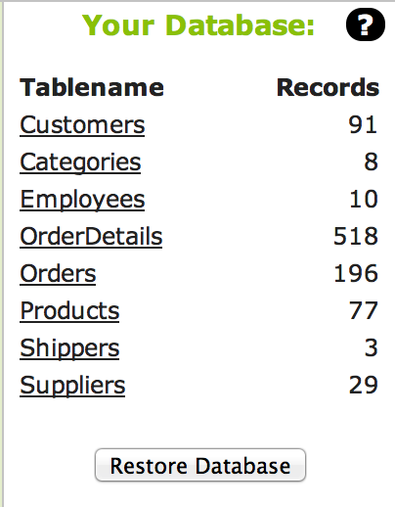
Each line shows # of records or “rows” in the table
Each of these is a table

Slide 8
What is in the
Customers Table?

Slide 9
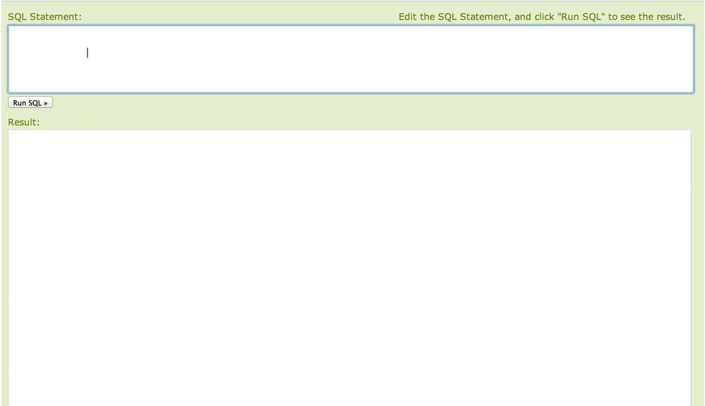

Slide 10

SQL keyword indicating a query in which we will be “selecting” data from a table.
Here we list which “fields” we want from the table – a ‘*’ indicates that we want all of them.
We can also list columns we want by name.
SELECT *
FROM
Customers;
A SQL keyword that tells us from which table we will be selecting our observations from.
The database table we are selecting observations from.

Slide 11
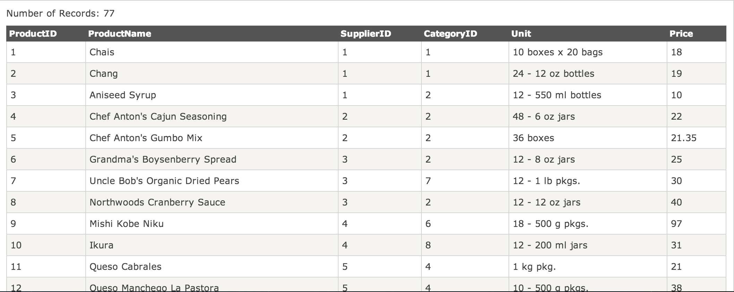
These are the “attributes” or “fields” of the table – also sometimes called “columns”
These are the “records” or “rows” from the Products table

Slide 12
You try it:
Get all the rows from the
Products table

Slide 13
SELECT *
FROM
Products;

Slide 14
What if we only want
the price?

Slide 15
SELECT Price
FROM
Products;

Slide 16
What if we want Price
and ProductID?

Slide 17
Note the inclusion of a comma separating the fields we are selecting
SELECT Price,ProductID
FROM
Products;

Slide 18
Let’s find the cheap products (say price < $10)

Slide 19
SELECT *
FROM
Products
WHERE Price < 10;
This is, appropriately enough, called a “where clause”

Slide 20
You try it:
Get all rows in Products table where Price is greater than or equal to $30

Slide 21
SELECT *
FROM
Products
WHERE Price >= 30;

Slide 22
How about products
less than $10 but greater than $5?

Slide 23
SELECT *
FROM
Products
WHERE Price <10
AND Price > 5;
This AND lets us string together more conditions

Slide 24
Any ideas? Read as “less than” OR “greater than” which just means “not equal to”
SELECT
FROM
Products
WHERE …
Price > 10
Price < 10
Price < 10 AND Price > 5
Price < 10 OR Price > 25
Price <> 100
Price > 2 OR Price = 1
(Price > 2 AND Price < 10) OR Price = 1

Slide 25
How many products have a price less than $10?

Slide 26
This COUNT is a function counts up the # of rows that satisfy the criteria
SELECT
COUNT(*)
FROM
Products
WHERE Price < 10;

Slide 27
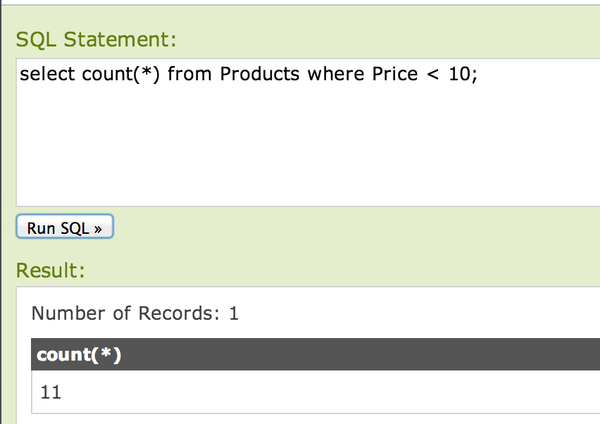
The answer is 11

Slide 28
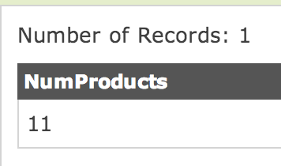
We can rename using AS – we made up the name “NumProducts”
SELECT
COUNT(*) AS NumProducts
FROM
Products
WHERE Price < 10;

Slide 29
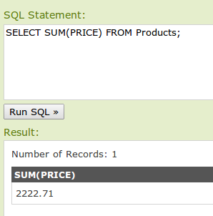
What’s the total dollar
value of merchandise?
SELECT SUM(Price)
FROM
Products;

Slide 30
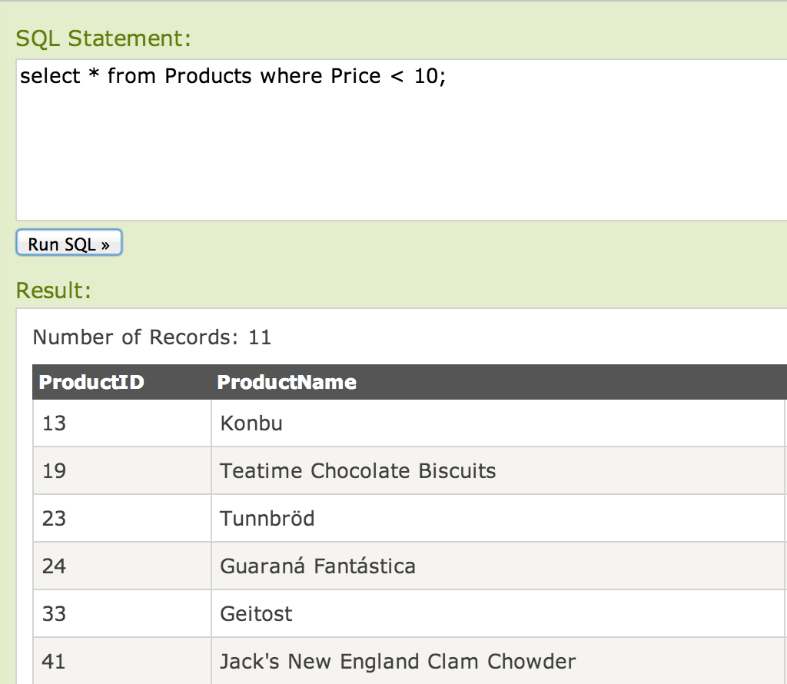
Here’s something interesting – the query results look like tables themselves

Slide 31
CREATE TABLE cheapstuff AS
SELECT *
FROM
Products
WHERE Price < 10;
We can create a new table in our database on the fly, based on our query!

Slide 32
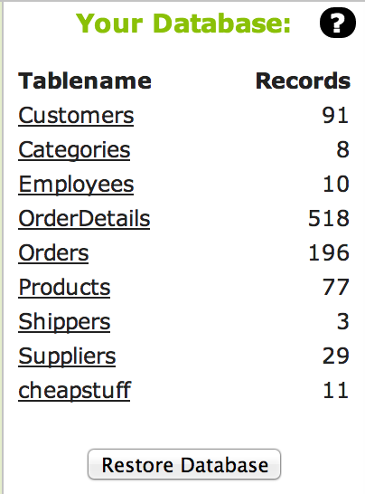

Slide 33
You try it:
Make a table of all expensive products (say Price > $50)

Slide 34
CREATE TABLE DearStuff AS
SELECT *
FROM
Products
WHERE Price > 50;

Slide 35
Can we list products
in price order?

Slide 36
DESCending order – can also do ASCending order
SELECT *
FROM Products
ORDER BY Price DESC;
This ORDER BY will give the results in some specific ordering
The field to order the results by
DESCending means highest value first

Slide 37
Can we create a new field based on price that lists whether a product is cheap or not?

Slide 38
This ensures that our resulting table will list the price
SELECT
Price,
CASE WHEN Price < 10
THEN ‘t’
ELSE ‘f’ END AS Cheap
FROM Products
This is conditional. In words, “if the price is less than $10, set the variable “Cheap” to ‘t’; if it’s not less than $10, set “Cheap” to ‘f’.

Slide 39
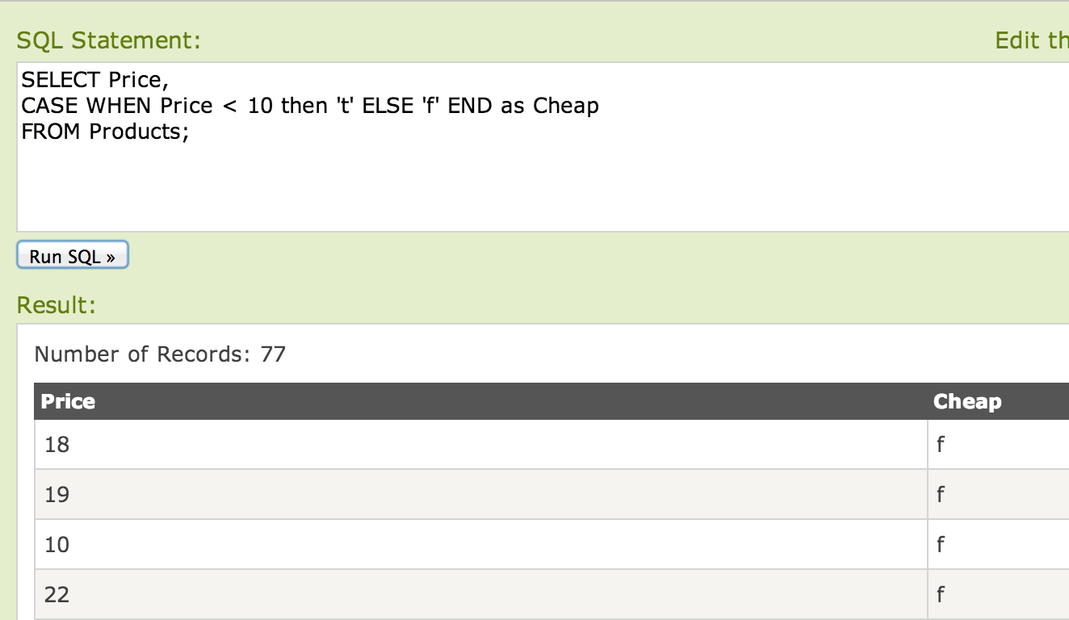

Slide 40
You try it:
Make a table with a field showing whether a price is between $5 and $10, restricted to products with a price less than $15.

Slide 41
SELECT Price,
CASE WHEN Price > 5
AND Price < 10
THEN ‘t’
ELSE ‘f’ END AS midrange
FROM Products
WHERE Price < 15;

Slide 42
What’s the breakdown between cheap and expensive products?

Slide 43
First, let’s create a table with the cheap classification
CREATE TABLE ProductPriceClass AS
SELECT Price,
CASE WHEN Price < 10
THEN ‘t’
ELSE ‘f’ END AS Cheap
FROM Products;

Slide 44
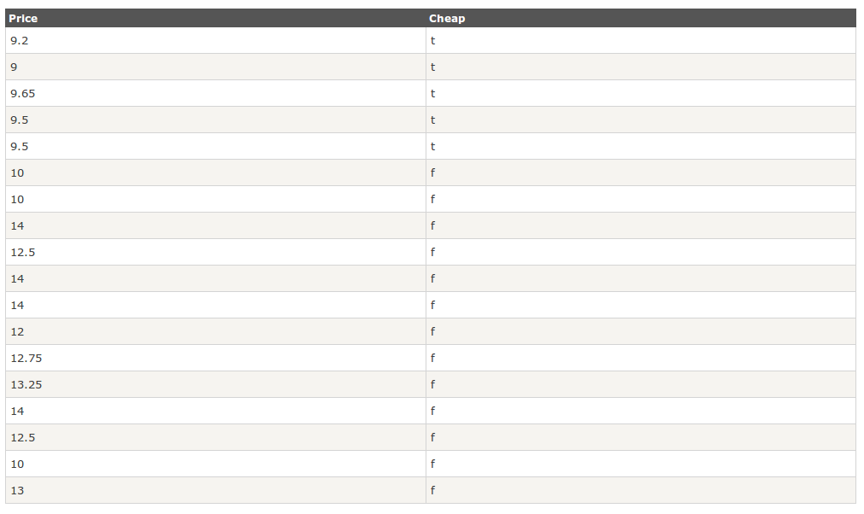
We now have a table that looks like this:
Column “Cheap” has two kinds of values; ‘t’ and ‘f’
If we “group” rows together by the value in “Cheap” and then count, we get:
5 rows where Cheap = ‘t’
13 rows where Cheap = ‘f’
Cheap | NumProducts
t | 5
f | 13

Slide 45
SELECT
Cheap,
COUNT(*) AS ProductCount
FROM ProductPriceClass
GROUP BY Cheap
This COUNT(*) is now counting all observations within the groups generated by “Cheap”
This GROUP BY keyword combo is critically important – it is setting up a very different kind of query than we have seen so far
This “Cheap” field (which we created) is what we are going to “group” results by

Slide 46
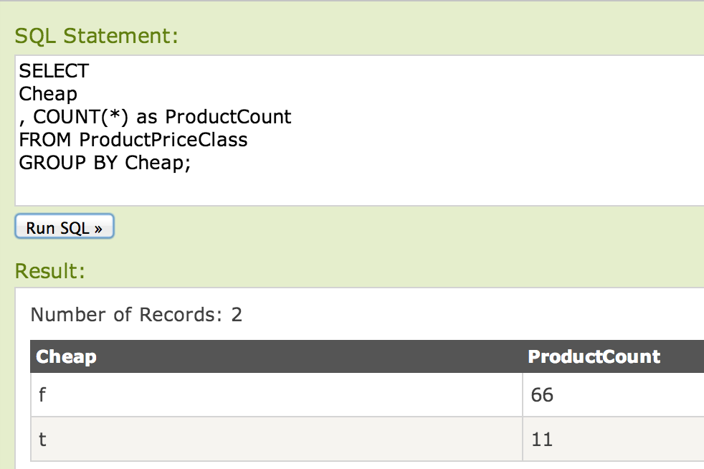

Slide 47
You try it:
How many products
at each price?

Slide 48
SELECT Price,
COUNT(*) as NumProducts
FROM Products
GROUP BY Price;

Slide 49
Related Question:
How many different prices do we have in the inventory?

Slide 50
SELECT DISTINCT(Price)
FROM Products;
This keyword DISTINCT gets all prices, then eliminates duplicates

Slide 51
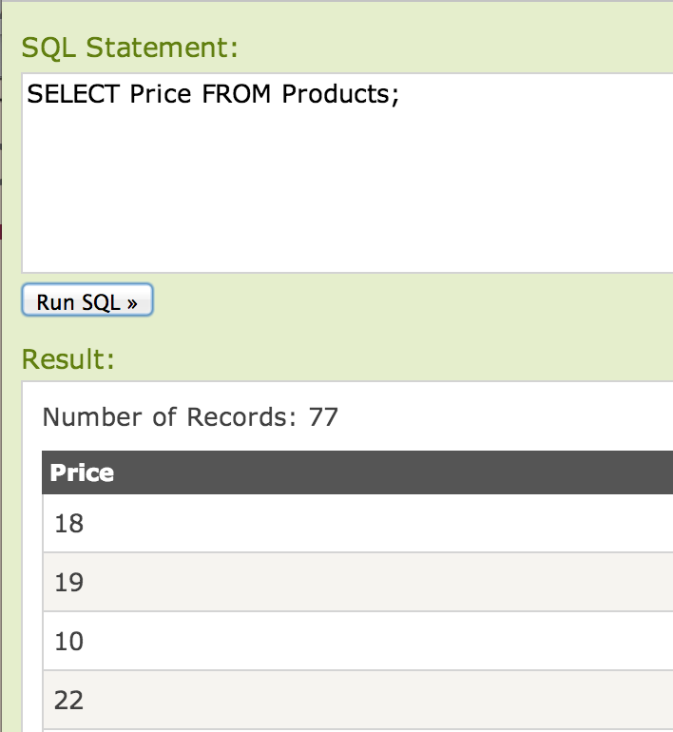
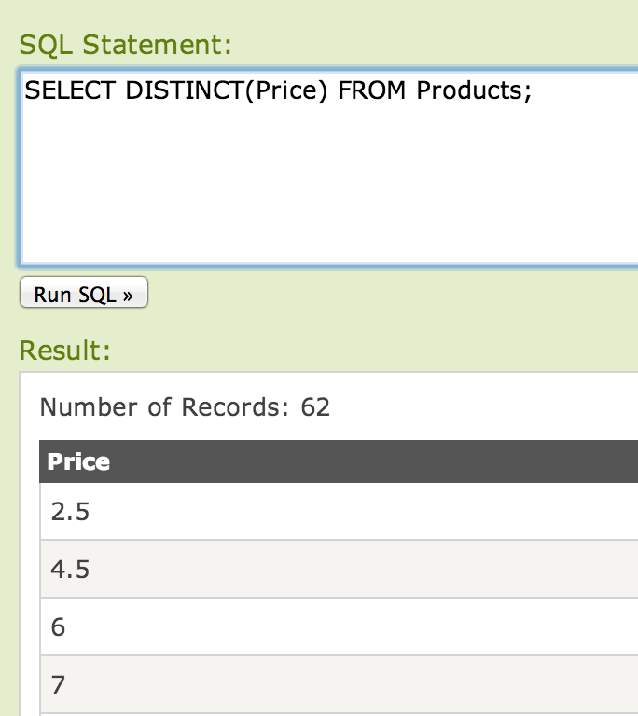
We have 77 products
But only 62 distinct prices

Slide 52
Another way to
count uniques

Slide 53
Another way to count uniques

Slide 54
This is called a “sub-query” – we can create tables on the fly and treat as if they already existed
SELECT
COUNT(*)
FROM (
SELECT
DISTINCT(PRICE)
FROM Products
)

Slide 55
Now for something
quite different

Slide 56
We actually have
multiple tables

Slide 57
How are they related?
Each customer can have multiple orders
Each order can have multiple products
But each customer, order, and product should be unique
In a database, keys serve to:
Uniquely identify entities (like orders and customers)
Document relationships between entities

Slide 58
This is a special field – it is called the table’s “Primary Key” – it uniquely identifies a row
This is a special field – it is a “Foreign Key” – it is the primary key to some other table.

Slide 59
Let’s look at the relationship between
customers and orders.

Slide 60
One-to-many relationship?
Some customers have more than one order
How can we tell?
SELECT COUNT(DISTINCT(CustomerID)) FROM Orders;
SELECT COUNT(*) FROM Orders;
What’s the distribution of orders per customer?

Slide 61
SELECT
CustomerID,
COUNT(*) AS NumOrders
FROM Orders
GROUP BY CustomerId
ORDER BY NumOrders DESC;

Slide 62
What if we want to see orders by Customer Country?
Problem: “Country” isn’t in the Order table. If it were, we could just do a “GROUP BY”
Solution: We can do a JOIN. A join lets us combine columns from different tables, as needed.
Great discussion / visualization of different kinds of joins: bit.ly/allthejoins

Slide 63
Join
… FROM A
{LEFT, RIGHT, INNER, OUTER} JOIN B
ON A.primary_key = B.foreign_key
LEFT JOIN: everything in A, only rec’d in B that match
RIGHT JOIN: everything in B, only rec’d in A that match
INNER JOIN: has to be in both
OUTER JOIN: everything in both tables, regardless

Slide 64
What do we want?
For each order, get the Country of the associated Customer

Slide 65
Note that we are using ‘o’ and ‘c’ as aliases for Orders and Customers table – this is because if same field name appears in two different tables, SQL doesn’t know which one you are talking about
SELECT
o.OrderID,
c.Country
FROM Orders AS o
LEFT JOIN Customers AS c
ON o.CustomerID = c.CustomerID

Slide 66
Take every record from “Orders” and then match it up with “Customers” on the basis of CustomerID
SELECT
o.OrderID, c.Country
FROM Orders AS o
LEFT JOIN Customers AS c
ON o.CustomerID = c.CustomerID;

Slide 67
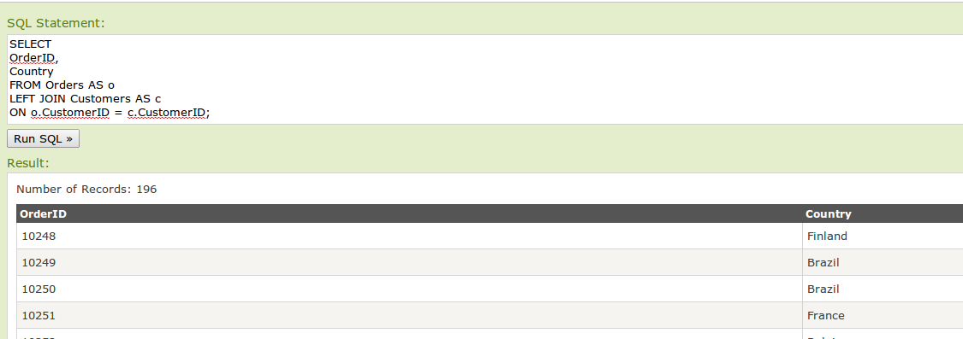
Note same # of records in Orders as in our LEFT JOIN query
Reason: Every order has 1 and only 1 associated customer, so every order has a “match”

Slide 68
What if I don’t match CustomerID? (don’t run this at home)
When does 1 = 1 ?
Always. So SQL matches up every record of Orders with every record in Customers
SELECT
o.OrderID,
c.Country
FROM Orders AS o
LEFT JOIN Customers AS c
ON 1 = 1;

Slide 69
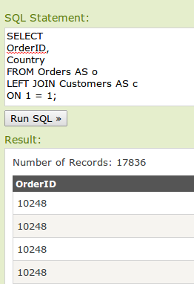
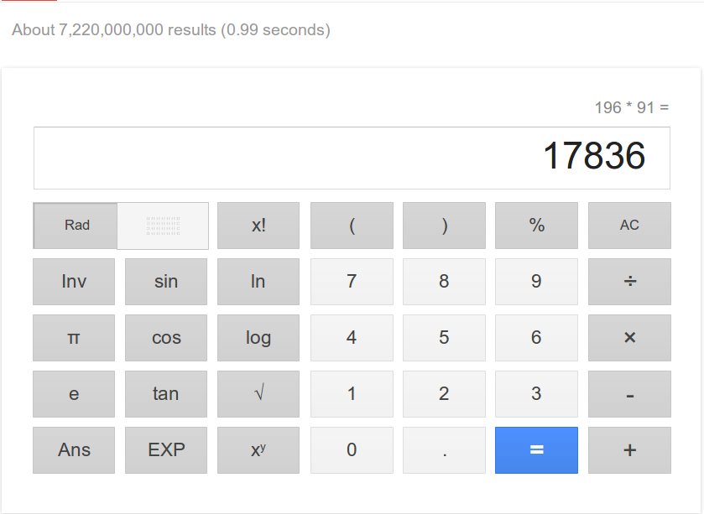
The 1 = 1 query matches all to all – the number of records is just the (records in 1) x (record in 2)

Slide 70
What if a customer record is missing? Let’s delete the customer with the lowest ID that made an order
DELTE FROM Customers
WHERE CustomerID = 2;

Slide 71
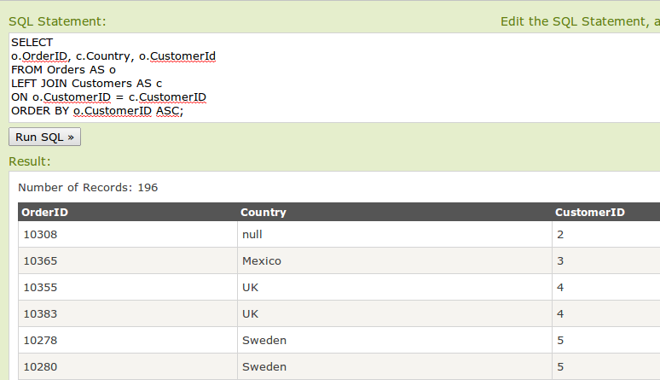
Now let’s re-run our LEFT JOIN
slightly modified
‘null’ value for Country – this is because no longer a matching record (we deleted it)
SELECT
o.OrderID,
c.Country,
o.CustomerID
FROM Orders AS o
LEFT JOIN Customers AS c
On o.CustomerID = c.CustomerID
ORDER BY o.CustomerID ASC;

Slide 72
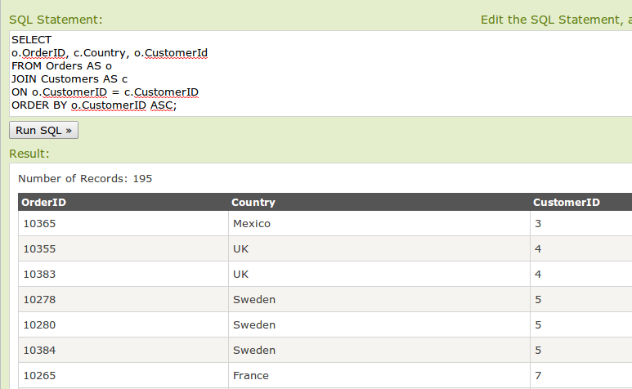
What if we only want records where we have a customer?
Replacement of LEFT JOIN with just JOIN causes the null record to be dropped
SELECT
o.OrderID,
c.Country,
o.CustomerID
FROM Orders AS o
JOIN Customers AS c
On o.CustomerID = c.CustomerID
ORDER BY o.CustomerID ASC;

Slide 73
Let’s go back to our original question:
Geographic breakdown of orders
Make a sub-query that returns each customer Country
Have outer-query that counts up countries with a GROUP BY
SELECT Country,
COUNT(*) AS NumOrders
FROM
(SELECT
Country
FROM Orders AS o
JOIN Customers AS c
On o.CustomerID = c.CustomerID)
GROUP BY Country
ORDER BY NumOrders DESC;
First, let’s bring back Customer #2

Slide 74
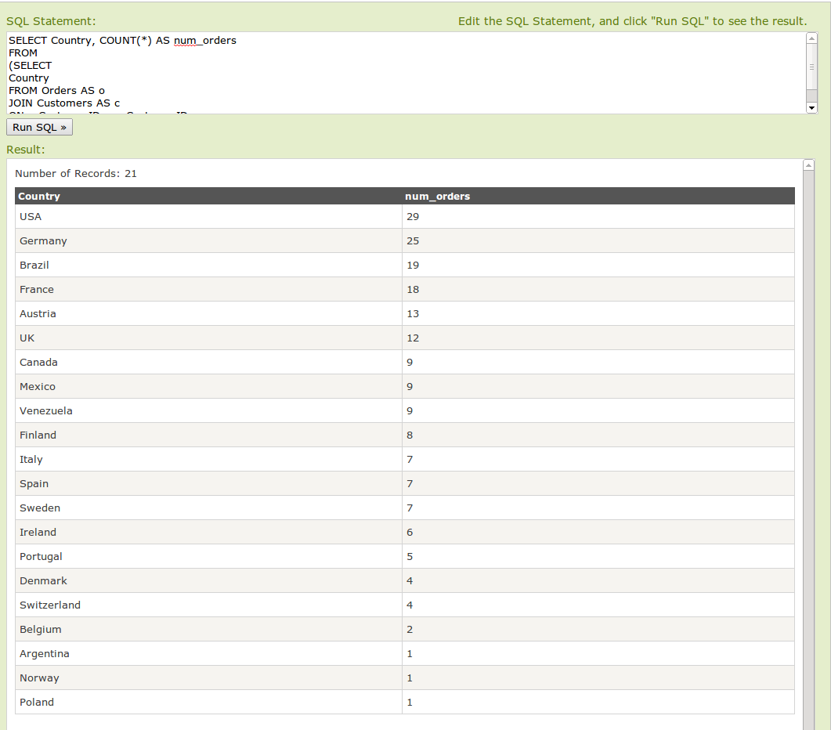

Slide 75
Questions
1. What distinct countries are the suppliers from?
2. For each supplier, what is the average price of the products they sell?
3. Who is the best shipper by number of orders shipped?
4. What is the quantity of each product sold?
5. Give us the name of each product as well as the quantity sold of the product.

Slide 76
Answer 1
1. What distinct countries are the suppliers from?
SELECT DISTINCT(Country)
FROM Suppliers

Slide 77
Answer 2
2. For each supplier, what is the average price of the products they sell?
SELECT SupplierID
,AVG(Price)
FROM Products
GROUP BY SupplierID

Slide 78
Answer 3
3. Who is the best shipper by number of orders shipped?
SELECT ShipperID
,COUNT(*) AS NumOrdersByShipperID
FROM ORDERS GROUP BY ShipperID

Slide 79
Answer 4
4. What is the quantity of each product sold?
CREATE TABLE ProductQuant AS
SELECT
ProductID
,SUM(Quantity) AS TotalQuantSold
FROM OrderDetails
GROUP BY ProductID

Slide 80
Answer 5
4. Give us the name of each product as well as the quantity sold of the product?
SELECT
b.ProductName
, a.TotalQuantSold
FROM TEST AS a
LEFT JOIN Products AS b
ON a.ProductID = b.ProductID

Slide 81
Acknowledgement
John Horton
Assistant Professor of Information,
Operations and Management Sciences

